Slide 1
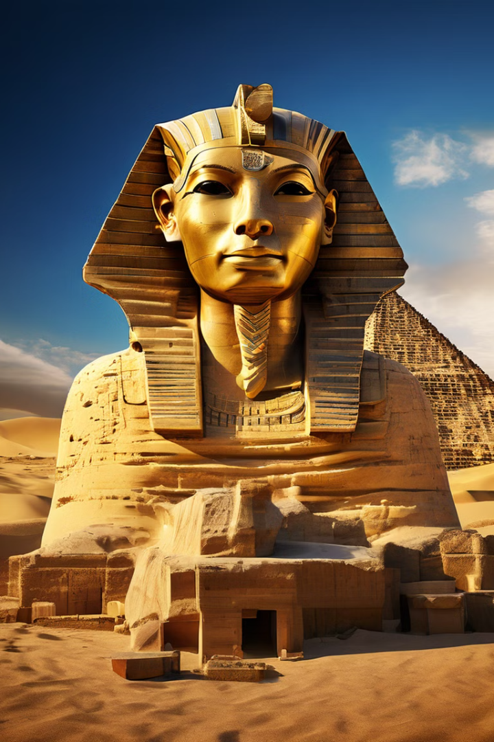
Image Prediction for Egyptian Tourist Attractions
Team name : Team4
Harness the power of computer vision and deep learning to build an intelligent system that can accurately identify and classify iconic Egyptian tourist attractions in images. This project aims to develop a robust model that can aid in navigation, planning, and exploration of Egypt's rich cultural heritage.

Slide 2

Introduction to Computer Vision and Deep Learning
Computer Vision
Deep Learning
Applications
Deep learning is a powerful subset of machine learning that utilizes artificial neural networks to learn from complex data and make predictions.
Together, computer vision and deep learning can be applied to a wide range of tasks, such as image classification, object detection, and scene understanding.
The field of computer vision focuses on enabling machines to interpret and understand digital images and videos, just as humans do.

Slide 3

Dataset: Egyptian Monuments and Artifacts
Diverse Collection
Labeled Data
The dataset includes a comprehensive collection of images covering a wide range of Egyptian cultural and historical sites and artifacts.
Each image is carefully annotated with relevant information, such as the name, location, and historical context of the depicted subject.
Data Quality
Continuous Expansion
The images are high-resolution and captured under varying lighting conditions, ensuring the model's robustness and adaptability.
The dataset is regularly updated to include new discoveries and developments in the world of Egyptian archaeology and tourism.

Slide 4

Convolutional Neural Network Architecture
1
Convolutional Layers
These layers extract low-level visual features, such as edges and shapes, from the input images.
2
Pooling Layers
These layers reduce the spatial dimensions of the feature maps, while preserving the most important information.
3
Fully Connected Layers
These layers combine the extracted features to make high-level predictions, such as image classification.

Slide 5





Training the Model: Hyperparameter Tuning
Learning Rate
Batch Size
Determines the step size during the optimization process, balancing convergence speed and stability.
Controls the number of training samples used in each iteration, affecting the model's generalization ability.
Epochs
Regularization
Defines the number of times the entire dataset is passed through the model during training.
Techniques to prevent overfitting and improve the model's ability to generalize to new data.

Slide 6
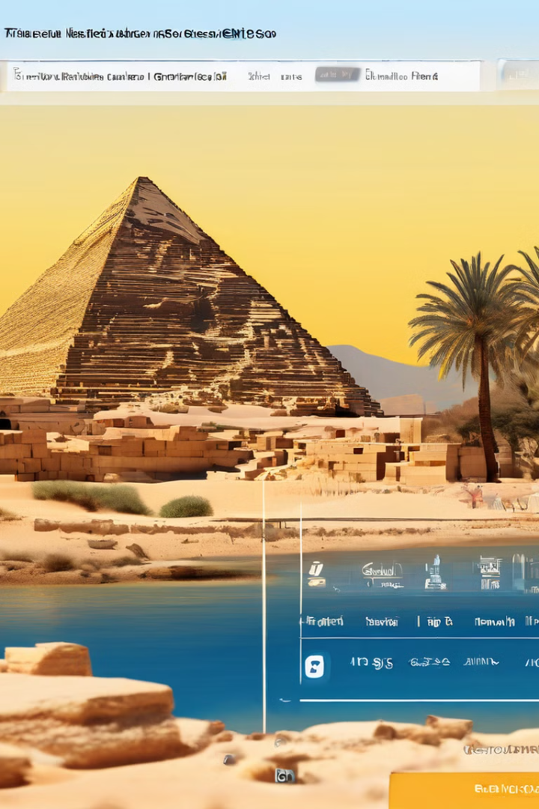



Deployment: Building a Web Application
Upload Image
Users can upload images of Egyptian monuments and artifacts to the web application.
Prediction Model
The trained deep learning model analyzes the uploaded image and provides predictions.
Interactive Visualization
The application displays the prediction results with interactive visualizations and information about the identified attraction.

Slide 7
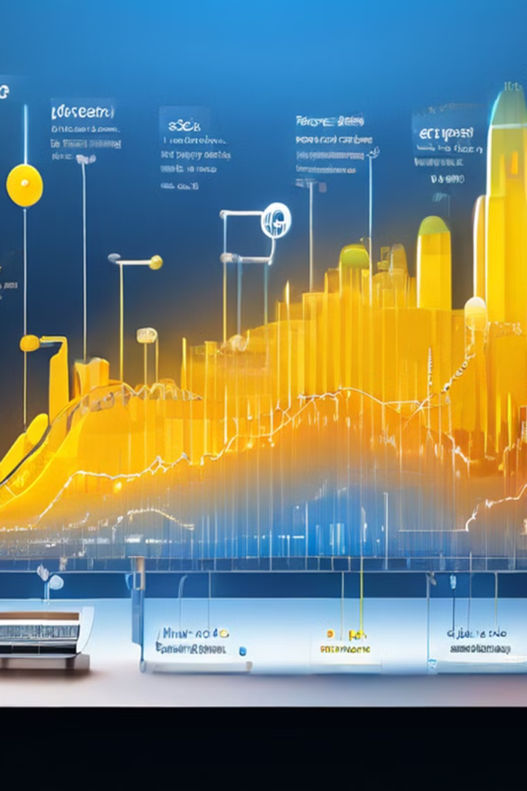
Real-Time Prediction and Inference
Inference Speed
The model can provide near-instantaneous predictions, enabling real-time analysis and decision-making.
Scalability
The system can handle high volumes of concurrent image uploads and deliver reliable predictions at scale.
Accuracy
The carefully trained model achieves high accuracy in identifying and classifying Egyptian tourist attractions.

Slide 8

Conclusion and Future Improvements
1
Continuous Learning
Ongoing model updates and fine-tuning to adapt to new discoveries and changes in the Egyptian tourism landscape.
2
Multilingual Support
Expanding the web application to support multiple languages, catering to a global audience of visitors.
3
Augmented Reality
Integrating AR functionalities to provide immersive experiences and enhanced navigation for tourists.
4
Partnerships
Collaborating with Egyptian tourism authorities and cultural institutions to further enhance the system's capabilities.

